Slide 1
Apps and Services--SysV
Much of this information is derived from CyberAces, https://tutorials.cyberaces.org/downloads/CyberAces_Module1-Linux_5_AppsAndServices_20150129.pdf
and has been modified for Ubuntu

Slide 2
Applications and services
Both applications and services are software processes
Both create a process (or more) when they run
Applications are started and used by the user
Example: web browser, terminal, etc.
Services are started by the OS and run in the background
They keep your OS running
Servers usually use services that start automatically. Examples are apache web servers, file servers, and mail servers
In Linux, services are also called daemons (pronounced DEE-mons or DAY-mons)

Slide 3
SysV versus systemd
The traditional system for booting Linux and controlling services is called SysV (pronounced system five.)
It dates to AT&T UNIX in 1983
Recently (2015), systemd has replaced SysV in most distributions
Most current distributions are backward compatible with SysV
Many methods attackers used to create evil services in SysV will still work in systemd, so we need to be aware of both SysV and systemd
This lesson will cover SysV, and the next will cover systemd

Slide 4
Linux Boot Process under SysV
Typical SysV boot process:
BIOS/UEFI starts the boot loader (often Grub or Lilo)
The boot loader puts the Linux kernel into memory
The kernel mounts disks/partitions and starts the init daemon
The init daemon starts services based on run level
A run level is a set of services that runs at startup
Most Linux systems have 6 run levels, which may vary between distributions
Run level 1 is single user mode, used for troubleshooting OS problems
Most users will use run level 3 or 5

Slide 5
Typical SysV Run Levels
0: Halt (shuts down the system)
1: Single User (troubleshooting and administration)
2: Multi-user mode, no networking
3: Multi-user mode with networking (common no-GUI mode, for servers)
4: not used
5: Multi-user mode with networking and GUI (common GUI mode for desktops
6: Reboot
Notes:
http://www.pathbreak.com/blog/ubuntu-startup-init-scripts-runlevels-upstart-jobs-explained

Slide 6
More Ubuntu Uniqueness
Debian/Ubuntu use different run levels than the previous slide
https://www.networkworld.com/article/3222070/maneuvering-around-run-levels-on-linux.html
In 2006 (Ubuntu 6), Ubuntu began moving away from SysV and adapted Upstart
Some services were controlled by Upstart and some by SysV
We’ll only cover the SysV compatibility
Services that haven’t moved to Upstart are stopped and started in the (almost) normal SysV way
Ubuntu 15 and above use systemd, covered in the next lesson
Still backwards compatible with SysV

Slide 7
Service Management in SysV (1)
Each service or daemon contains an “init script” (often written in BASH) to start, stop, restart, etc. that service gracefully
Contained in /etc/init.d
On traditional Linux the directory /etc/rc.d contains directories matching runlevels (/etc/rc.d/rcN.d where “N” is the runlevel)
For backwards compatibility, current Ubuntu has /etc/rc.N directories instead, where “N” can be 0 .. 6
Each runlevel directory contains symbolic links to scripts for services that should be started or stopped at the runlevel
Each link starts with “S” (start) or “K” (kill) followed by a number
The number gives the order the scripts should run in, S20xxx runs before S30xxx

Slide 8
Service Management in SysV (2)
It is very important that unnecessary services are removed or disabled
They expose attack surfaces and may have vulnerabilities
In CyberPatriots you will gain points by removing them
Editing symbolic links in the runlevel directories is tedious, so most distributions had command line tools or GUIs to do this
CyberPatriots recommends Boot-Up Manager, which works on SysV
sudo apt-get install bum
You can still find some evil services by checking /etc/rc3.d, /etc/rc5.d, and etc/init.d/rc.local

Slide 9
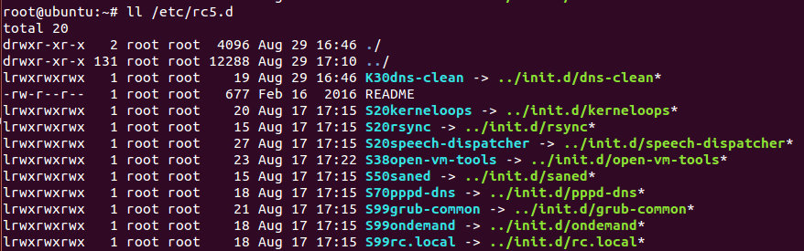
Sample /etc/rc5.d in Ubuntu 14 (1)
Non-Upstart services that are started in runlevel 5, GUI mode

Slide 10
Sample /etc/rc5.d in Ubuntu 14 (2)
When starting run level 5, init daemon looks in /etc/rc5.d (see last slide)
init runs scripts that the symlinks point to, in order
K30dns-clean
dns-clean kills services from startup
init runs the file that symlink K30dns-clean points to
/etc/init.d/dns-clean
S20kerneloops is next
init runs the file that symlink S20kerneloops points to
/etc/init.d/kernloops
… and so on (S20rysnc is next)

Slide 11
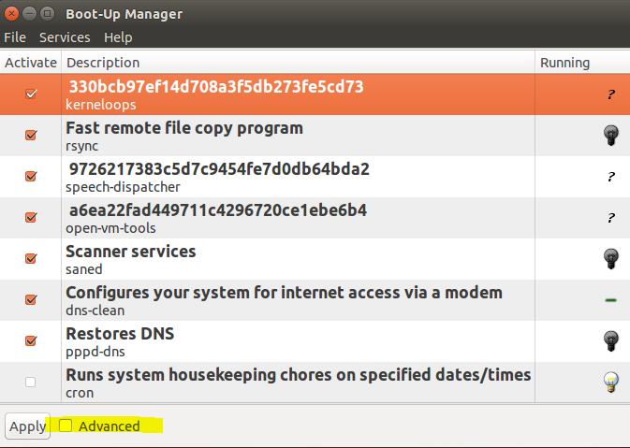
Boot-Up Manager (1)
Advanced mode shows services and run levels, so I prefer to use it

Slide 12
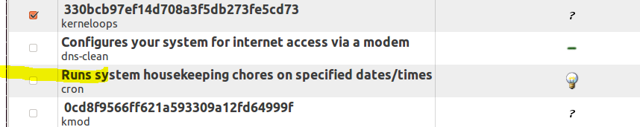
Boot-Up Manager (2)
Services with orange boxes are started by SysV
Uncheck and click apply to prevent them from starting at boot
Right-click will start, stop, or deactivate a service
Light bulb shows whether the service is running
There are many running services that don’t have activate set
These are controlled by systemd and not SysV, see cron in picture below

Slide 13
What’s normal?
Compare with a standard image (often called “gold” image)
Example, compare CyberPatriots image with the same version of Ubuntu that you installed yourself
If you see anything unusual
Use cat or less to see the contents of the service file in /etc/init.d
Use a search engine to look it up
The Ubuntu you installed may still have unnecessary services
CUPS is for printing. Do you need to be a print server?
Bluetooth is for wireless devices. Do you have any?

Slide 14
SysV service control via command line
Usually used to start, stop, or restart services
Controlling what starts automatically is done by systemd or rcN.d files
Boot-Up Manager is a GUI tool for the SysV (rcN.d) services
The command “service” allows you to start, stop, restart, or check status
service service_name command
Examples
service ssh status
services ssh start
services ssh restart

